Slide 1
Path Planning Behavior Trees
GAM 376

Slide 2
Path Planning
Graph search
finding the best path between nodes in a graph
Path planning
generating plausible movement for game agents
Graph search may help in path planning but not the whole story

Slide 3
Path Planning
Issues
the graph is an approximation of the game environment
good paths may need to deviate from the graph
quantization / localization
graph search is slow
agent may not be able to wait until a path is computed
tradeoff between cost and detail
more detailed graph = more precise paths
more detailed graph = more computational cost
the world is dynamic
the graph will not include non-stationary obstacles
are steering behaviors enough?
not always
agents have different capabilities
height
jumping ability
width
turning radius, etc.

Slide 4
Quantization / Localization
Quantization
converting positions in the game world
into nodes in the graph
the fewer nodes, the more approximate the conversion
Localization
converting nodes into the graph
into real world positions
so that agents can move

Slide 5
Coarse Planning
Simple idea
Instead of a graph that encompasses the whole game space
Create a simplified graph
plan with that graph
use steering behaviors to handle the beginning and end
getting from starting point to first coarse graph node
getting from last coarse graph node to actual destination

Slide 6
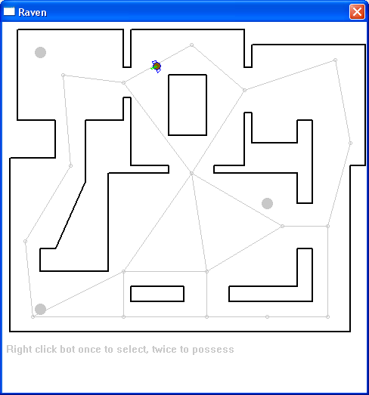
Points of Visibility
Create a graph such that each node is visible from at least one other
All part of the space should be “visible” from one node

Slide 7
Issues
Quantization / Localization
very rough because of graph coarseness
Graph can include additional info
places to hide
triggers for actions
Often created manually
won’t work for random or player-generated maps
easy to make poor choices

Slide 8
Expanded Geometry
A technique to produce POV graphs automatically
For each polygonal object
expand by ½ agent’s radius
place a node at each vertex
check for line of sight between nodes
add edges where there is visibility

Slide 9
Dirichlet Domains
Another manual scheme
Divide the world
by establishing a set of characteristics points p0...pn
A Dirichlet domain for point p0
is all the points in the world
that are closer to p0
than to any other point
Can be weighted to make some points more expansive than others

Slide 10
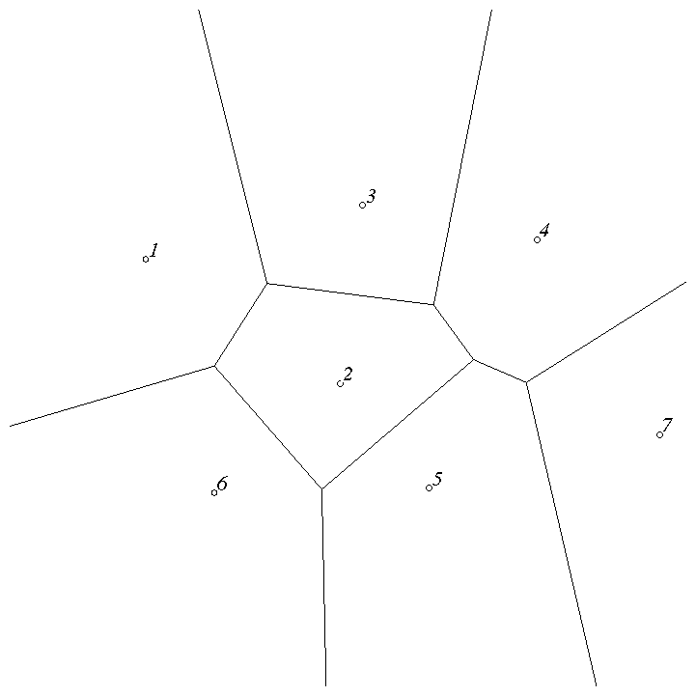
Example

Slide 11
Issues
Easy to use and edit
Sensitive to placement of characteristic points
especially if weights are used
possible to have an "empty" domain
Very common for manual mesh creation

Slide 12
NavMesh
An automated technique
Represent the world as connected convex spaces
An agent can go anywhere in the convex space
without worrying about obstacles
If I can navigate to the right mesh space
then steering behaviors will do the rest
More on this later

Slide 13
How much detail?
A coarse graph has relatively few nodes and edges
represents “primary” paths through a space
A fine-grained graph has many nodes
represents all or most possible paths
Pluses
Path planning is quick with few nodes
Minuses
Paths can be ugly with few nodes
Example

Slide 14
Fixing bad paths
Sometimes suboptimal paths can be fixed
by smoothing
more later

Slide 15
Generating Graphs
An important question for a navigation graph
Can it be created from the level design automatically?
Answer
Yes, but
it depends what kind of graph you want
it depends what you want to do with it
No
any automatically generated graph will need some manual tweaking
Usually navigation graphs are generated
by a engine-specific tool
then exported to a 3-D design environment
then edited to have the right characteristics
the vendors say everything “just works”
this is hype

Slide 16
NavMesh
If your level design consists of polygonal models
most do
You can generate a navmesh automatically
triangular or polygonal
Article in Game Programming Gems V. 2

Slide 17
2 types of NavMeshes
Triangle based
All polygons must be triangles
When done correctly, will not hug walls too tightly
N-Sided-Poly-based
Can have any number of sides, but must remain convex
Can usually represent a search space more simply than triangle based (smaller memory footprint)
Can lead to paths that hug walls too tightly

Slide 18
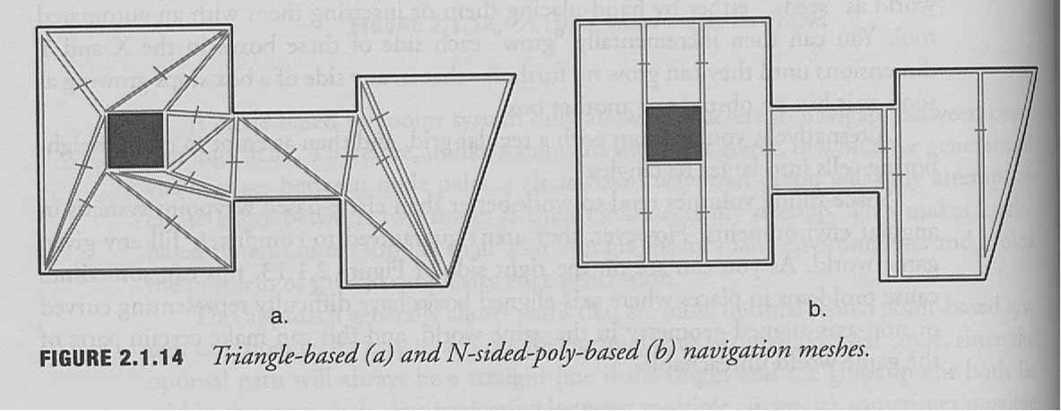
2 types of NavMeshes

Slide 19
NavMesh Representation
A polygon is a set of edges
Each edge connects to (at most) one other polygon
Each edge is a vector in world space
has (x,y,z) coordinates
For search purposes
polygons are graph-nodes
shared edges are graph-edges

Slide 20
Building a NavMesh
Based on the bounding geometry of the level
You want the largest polygon
that coincides with bounding vertices at all points
In general, you have only one shared edge
with any other polygon
otherwise break up

Slide 21
X

Slide 22
NavMesh Pathfinding
To find a path from A to B
find the polygon enclosing A
find the polygon enclosing B
search from A to B
Results
the edges that must be traversed between spaces
usually aim for the midpoint of each edge

Slide 23
Spatial Partitioning
Quantization: how to find the polygon for a given point?
spatial partitioning
as in flocking
This is the answer to questions like
“what objects are near point (x,y,z)?”
Don’t want to have to search all objects

Slide 24
Spatial Partitioning
Divide the world into partitions
usually based on the presence of objects
few objects = few partitions
each partition has some small number of objects
too many objects in a partition
split the space
Techniques
binary space partitioning (BSP)
very popular in games
quad-trees
oct-trees
others

Slide 25
Path Planning in Raven (AI Book)
Uses a fine-grained graph
generated by flood fill of the graph space
Uses A* with a Euclidean distance heuristic
Process
find closest visible unobstructed node N1 to agent
find closest visible unobstructed node N2 to target
search between N1 and N2
seek to N1
seek from node to node along path
seek to target after N2
Very straightforward
Example

Slide 26
Path to Item Type
What if we don’t have a target node?
Find the closest health pack
Don’t want to run a separate search for each health pack location
Use Dijkstra’s algorithm instead
searches all paths of cost k before looking at more expensive ones
will find the closest matching destination

Slide 27
Smoothing
Paths look unnatural
especially beginning and end
agents don’t move smoothly through space
because they are following the graph edges
Solution
delete edges if the intervening node can be reached directly

Slide 28
Rough Smoothing
Pair-wise edge deletion
Move along the path
If the next node can be reached directly
delete the extra edge
go directly to next
Keep checking
O(n)

Slide 29
Precise Smoothing
Greedy edge deletion
Move along the path
Consolidate as many edges as possible
from current node
Then go to next
O(n²)

Slide 30
Planning Efficiency
Planning is slow
We may need to have many agents planning their motion
Cannot afford to do lots of calls to the path planner

Slide 31
Pre-computing
Trade off space vs time
Compute paths in advance
store in a lookup table
For each node
store the most efficient path to every other node
Requires n² space
but constant time lookup
some paths may be (much) more frequently requested
Not compatible with dynamic environments

Slide 32
Time-sliced Planning
Basic idea
Path planning must not slow down the game
no matter how many agents there are
Obviously
we cannot assume that path planning can be complete
in a single execute cycle
Must decouple path planning as a separate process
Benefit
we can treat this as a separate resource
fix the CPU budget for it

Slide 33
Basic idea
Separate path planner object
Agents make planning requests
asynchronous
Agents notified when a path has been computed
Agents must have something to do while planning is happening

Slide 34
Search cycle
Inner loop
grab node
add to path
check for target
expand search frontier
If we encapsulate data separately
(start, target, path, search queue)
then we can work on several searches at once
Each execute cycle
the planner processes one node
not arbitrarily costly

Slide 35
Waiting for Planning
Agent must not be idle during planning
looks really stupid
Agent can
wander
not efficient, but easy
seek toward destination
looks purposeful
Caution
agent may have moved from path start point
must use smoothing to reshape path to current location
Example

Slide 36
Hierarchical Pathfinding
How to get to the Piazza San Marco?
cab to the airport
plane to Venice
then bus,
then water taxi
We don’t start by thinking about the one-way streets in the Loop

Slide 37
Hierarchical Pathfinding II
Multiple graphs at different resolutions
a navmesh for the level
a complete grid for each room
To traverse the level
we first plan at the higher level
result = a path of “room-sized” nodes
each edge enters / exits one polygon face
To get from face to face in the room itself
we plan again at the lower level
such plans are perfect for pre-computing

Slide 38
Problems
Anomalies in hierarchical paths
a rough graph may miss details that can shorten paths
esp. if generated automatically: narrow shortcuts
weights on the hierarchical graph have to "summarize" possible low-level paths
no way to do this and be right all the time
Agent capabilities
not all spaces can be traversed by agents equally
fat vs skinny
can jump vs can’t jump
turning radius
if you don’t want a different graph for each agent
must embed constraints in the graph somehow
must include constraints in graph search
harder to do hierarchically

Slide 39
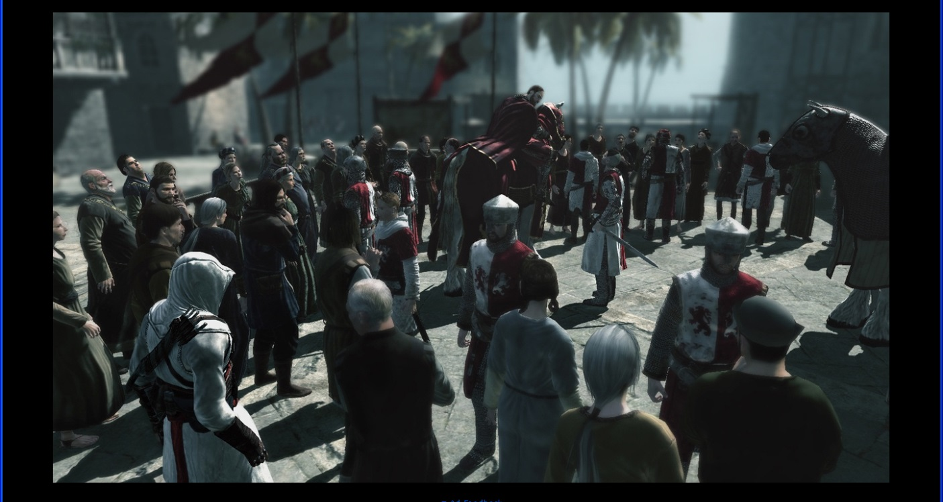
Assassin’s Creed

Slide 40
Path planning in AC
all NPCs have specific destinations
up to 160 in first game
Use “highways” established by level designers
basically coarse navmesh
also a fine navmesh
used to navigate to the highway
guard NPCs
have to chase the player
use the finer navmesh
also use “special” links include jumping and climbing abilities
had to make guard physical abilities roughly = assassin’s
otherwise too difficult to plan

Slide 41
Plan Failure
Lack of progress
in a dynamic world
planning may fail
the agent may not get where he is going
Example

Slide 42
Re-planning
The plan must include a failure condition
agent fails to make progress toward goal
agent fails to reach goal in anticipated time period
Then call the planner again
Trade off
the longer we wait for failure
the dumber lost agents look
the shorter we wait for failure
the more unnecessary planning we do

Slide 43
Goal-Oriented Behavior
GAM 376

Slide 44
Goal-Oriented Behavior
Often called “planning”
planning is deciding what to do
that’s mostly what an AI system in a game does
Not path planning
we’re done talking about that
goal-oriented behavior is clearer, maybe

Slide 45
AI Planning
Planning has a long history in AI
Roots in “problem solving” systems
Classic example
(GPS, 1957)
3 missionaries and 3 cannibals
one boat can carry 2
but cannibals can’t outnumber missionaries

Slide 46
Strips Planning
Classic formulation of the planning problem (1971)
Starting point
situation described as a collection of states
End point
desired resulting world state
Operators
operations that can change the world state
pre-conditions
what must be true for the operator to work
post-conditions
how the world will be modified by the operator
Ad for CSC 380 here

Slide 47
Example
Operator
moves m missionaries and n cannibals from the right to the left bank
pre-condition
>= m missionaries on the right bank
>= n cannibals on the right bank
remaining missionaries on right bank not outnumbered by cannibals
not outnumbered in the new grouping on the left
post-condition
m fewer missionaries on the right
n fewer cannibals on the right
m more missionaries on the left
n more cannibals on the left

Slide 48
State space search
Usually we conceptualize this type of planning as search
Nodes
sets of world states
Edges
operators
What sequence of operators leads from current state to goal state?
Can be solved in the same ways
A* for example
heuristics can be hard to come by
very domain-specific

Slide 49
Typical approach
Backward chaining from the result
Start
we want a particular state of the world to be true
find an operator that would make it true
if we can apply this operator right now
we’re done
if not, it must be because some pre-condition isn’t satisfied
Recursively
try to generate a state of the world so that all the preconditions are true

Slide 50
Problems
Very slow on realistic problems
many operators
many, many legal states of the world
Plan first, act later
not practical in most applications
esp. games
Closed-world assumption
all relevant states known
true in games
but only if you’re cheating
not in real-world robotics
Always starts from scratch
previous planning effort wasted
doesn’t improve with practice

Slide 51
In games
Novel situations (should) never arise
constructing novel plans is not required
can reuse known plans
What we need is
arbitration between competing goals
decomposition of high-level goals
choice of known plan to employ
sequencing of plan steps
monitoring of plan execution
re-planning on failure
(getting better over time)
Behavior trees
Buckland (incorrectly) calls this planning

Slide 52
Behavior trees
Hierarchical planning
idea that a high-level might be satisfied many ways
Example
get to work
possible plans
take the el
take the Metra
car-pool with colleague
drive self

Slide 53
Decomposition
A plan is a series of steps
each of which is itself a goal
sub-goal of the original
Example
take the Metra
walk to train station (arrive before 8:50)
board train (have ticket)
get off train
get to CDM

Slide 54
Decomposition
Sub-goals may themselves require plans for their solution
Example
get to CDM from Metra
walk
cab
bus

Slide 55
Decomposition
Eventually we reach “atomic actions”
sub-goals that cannot be further decomposed
actions that the agent can just perform
get on bus
or is it step forward one pace?
However
we still need to monitor that the action is successful
may need to replan
Example
bus drivers on strike
change high-level plan to walk

Slide 56
Action planning framework
A few top level goals
related to game success
Raven
health
kills
weapons
Arbitration system
decides which goal at any given time
Plan library
set of pre-made plans for given goals
Sub-goal queuing and monitoring
maintaining a queue of subgoals

Slide 57
Goals
Methods
activate
calls when the goal is in operation
process
called as part of the update cycle
handle message
called whenever the agent gets notified
terminate
cleans up when the goal is complete
Composite goals
have associated subgoals
responsibilities
create and queue subgoals
forward messages to subgoals
reactivate if subgoals fail
terminate subgoals if terminated

Slide 58
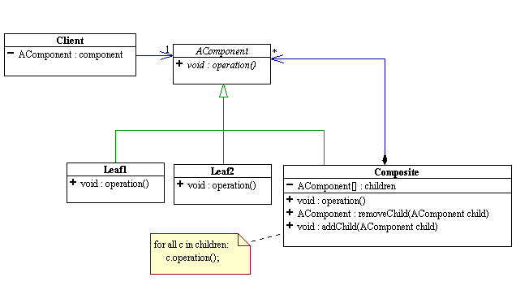
Composite pattern

Slide 59
A behavior tree
Goal_Think
Attack
Weapon
Explore
Health
if visible and there is dodging room
if not visible
if dodging not possible
Hunt Target
Dodge
Move Toward
recall last known position
Move to Position
if not in FOV
if in FOV
Follow Path
Seek to Position
until planning completes
...
Invoke Planner
Seek to Position
Traverse Edge
Traverse Edge

Slide 60
Note
Weapon handling and firing are autonomous
Don’t have to plan for this

Slide 61
Recovery
For TraverseEdge and SeekToPosition
Calculate expected arrival time
When this time is exceeded
mark goal as failed
Goal fails when subgoal fails
when goal fails
it is reactivated
causing replanning

Slide 62
Goal arbitration
High-level goals compete
should I attack or heal?
should I hunt weapons or enemies?
Special desirability functions
health = k x (1-Health)/DistToHealth
k must be tweaked empirically

Slide 63
Behavior tree in action
Colors
black = inactive
green = complete
red = failed
blue = active
Indenting shows hierarchy

Slide 64
Differences from FSM
Let’s try to build one
GoToLocation

Slide 65
State machines
Essentially propositional
no communication between states
everything a state needs should be a state of the world
Possible to fudge
“current path”
transition pops edge off this variable
state machine is tied to agent implementation
Where to go afterwards?
transition out of a state can’t be dependent on context
Subgoals/behaviors are reusable
hierarchy allows for context
state machine
“seek while waiting for plan” has different transitions from
“seek to enemy in FOV”
subgoals are the same

Slide 66
State machines
Plans handle interruption
simply add a new goal to the queue
when it is complete
others will still be there
(can get complex, though)
Plans handle extended action sequences
requires multiple states in FSM

Slide 67
FSMs as behavior trees
It is usually easy to implement FSMs as plans
FSM itself is a goal
States are plan steps
transitions
success or failure of step

Slide 68
Behavior trees as FSMs
In theory
you can always turn a behavior tree into a finite state machine
In practice
the size of the FSM can grow exponentially
not easy to create / maintain / debug

Slide 69
Multi-agent Behaviors
In SimpleSoccer
we had a team state machine
and individual state machines
We can do a similar trick with behavior trees
Idea
create behaviors for the whole unit
instead of steps
related tasks

Slide 70
Example
Attack with flank
flank
move to the side and attack from angle
cover
stay back
use suppressing fire to pin target down
Attack with scout
scout
move forward under cover
report enemy position
flush out
stay back
use splash weapons like grenades

Slide 71
Advanced issues
Command queuing
subgoal structure can be used to issue commands
common in RTS games
Subgoal interference
what if subgoals repeated clobber each other
re-planning doesn’t help
blocks world example
the planner must notice that something is wrong
very hard to do
representation must be enhanced
so that a subgoal fails if it changes conditions established by sibling

Slide 72
Advanced issues
Prediction / Plan recognition
you can use a planning model to predict the player’s behavior
and then counter-plan
humans do this well
usually such things are scripted in games
Criticality
not all goals can be easily interrupted
a goal to jump over a gap
should remain active until it is completed
usually achieved by labeling goal as "critical"
and preventing overriding

Slide 73
Advanced issues
Animation planning
sometimes planning is used to generate low-level actions
corresponding to animation sequences
to achieve higher-level aims
like TraverseEdge
Examples
interacting with the world
doors
elevators
moving platforms
positional and footfall planning
planning agent positions
crouch, crawl, etc.
planning steps
necessary for animation
not important for high-level planning
usually

Slide 74
Learning
It is possible to get better over time?
see which plans work well in which circumstances
and which don’t
adjust planning
Yes, but

Slide 75
Learning
A lot of AI research has gone into such issues
case-based planning
reinforcement learning
But in games
great trepidation associated with adaptive algorithms
very hard to predict / debug
an adaptive AI may become too good

Slide 76
Active Objects
An alternative to planning
make the world model more informative
Associate messages with objects
“scents”
have those scents propagate through a level

Slide 77
Example
Need health
Health here

Slide 78
Active Objects
Objects’ messages
say what goal they can fulfill
“health here!”
“ammo here!”
Agents
can follow intensity gradient
towards goal
does not need an explicit plan

Slide 79
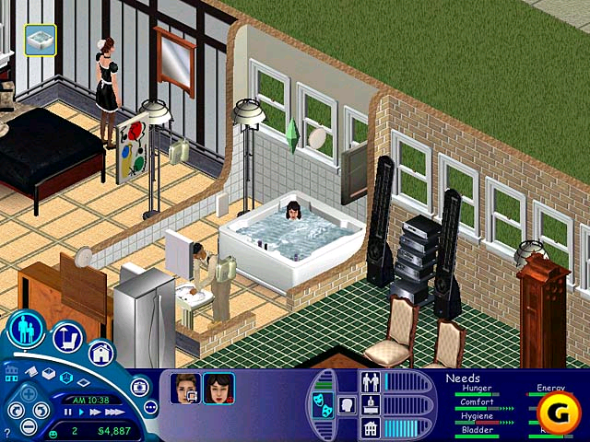
The Sims

Slide 80
Sims
Sims characters have “drives”
eat
socialize
bathe
They look for opportunities to satisfy those drives
requires recognizing objects and using them
in the real world
require attending to messages related to that drive
in the Sims world
The characters look like they know what a phone is for
but really the phone knows what it is for
the characters just respond to its signal

Slide 81
Rest of the quarter
3/6 Fuzzy Logic + Lab
New behavior lab
3/12
Raven bot due
3/13
Raven tournament
3/20
Final exam due

